Slide 1
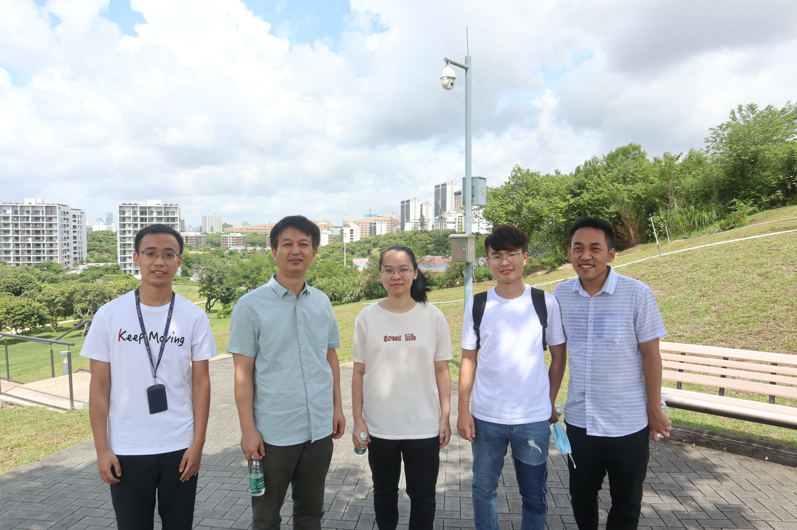
Happy birthday!🎇

Slide 2


On compatible groups
Zhaochen Ding
Joint work with Gabriel Verret
Yunnan University
2025.1.12

Slide 3
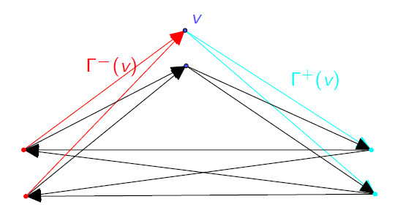
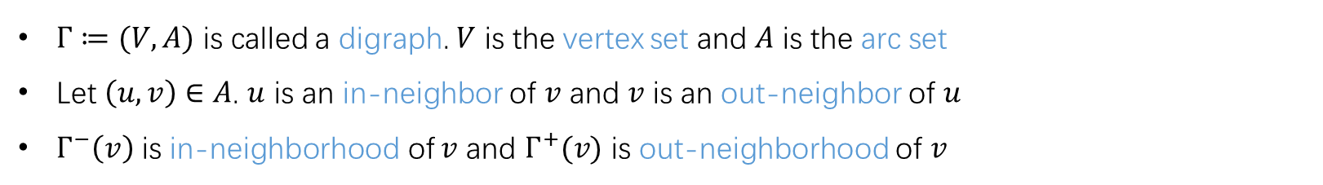
Background
$Γ≔(V,A)$ is called a digraph. $V$ is the vertex set and $A$ is the arc set
Let $\left(u,v\right)∈A$. $u$ is an in-neighbor of $v$ and $v$ is an out-neighbor of $u$
$Γ^{−}\left(v\right)$ is in-neighborhood of $v$ and $Γ^{+}(v)$ is out-neighborhood of $v$

Slide 4
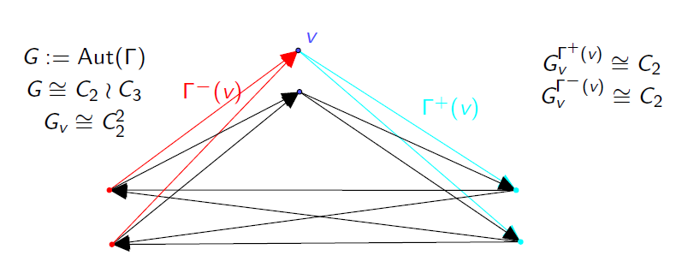

Background
Throughout, all digraphs and groups are FINITE
Let $Γ$ be a $G$-digraph and $v∈VΓ$.
Out-local action at $v$: $G_{v}^{Γ^{+}(v)}$. In-local action at $v$: $G_{v}^{Γ^{−}(v)}$
Question. What properties do $G_{v}^{Γ^{+}(v)}$ and $G_{v}^{Γ^{−}(v)}$ share?

Slide 5
Motivation
On vertex-primitive, arc-transitive digraphs.
  Li, Lu, Marušič, On primitive permutation groups with small suborbits and their orbital graphs, 2004
On local theory of digraphs.
  Giudici, Glasby, Li, Verret, Arc-transitive digraphs with quasiprimitive local actions, 2019

Slide 6
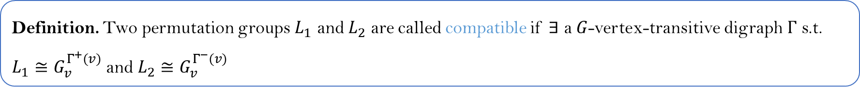
Compatibility for permutation groups
Definition. Two permutation groups $L_{1}$ and $L_{2}$ are called compatible if $∃$ a $G$-vertex-transitive digraph $Γ$ s.t. $L_{1}≅G_{v}^{Γ^{+}(v)}$ and $L_{2}≅G_{v}^{Γ^{−}(v)}$
Question. Given two permutation groups. Determine whether they are compatible.
(Giudici et al.) Compatible permutation groups have the same degree, the same number of orbits, and the same simple sections
(Sims) Compatible transitive permutation groups have a common non-trivial homomorphism image
(Cameron, Knapp) A group L compatible with a 2-transitive or 2-homogenous permutation group M is 2-trans or 2-homog respectively Moreover, L is abstractly isomorphic to M

Slide 7
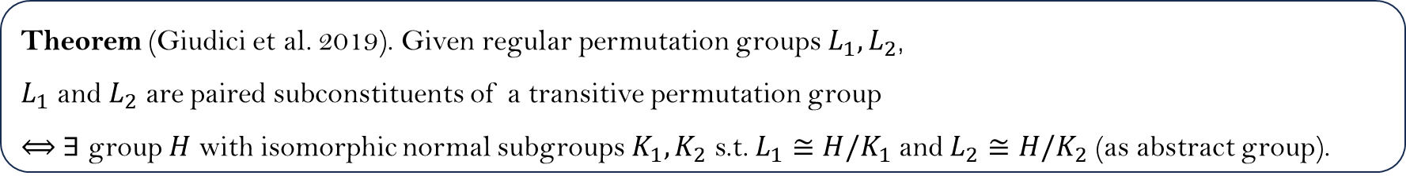
Compatibility for permutation groups
Theorem (Giudici et al. 2019). Given regular permutation groups $L_{1},L_{2}$,
$L_{1}$ and $L_{2}$ are paired subconstituents of a transitive permutation group
$⟺$ $∃$ group $H$ with isomorphic normal subgroups $K_{1}, K_{2}$ s.t. $L_{1}≅H/K_{1}$ and $L_{2}≅H/K_{2}$ (as abstract group).
This motivates us to define compatibility for abstract groups!

Slide 8
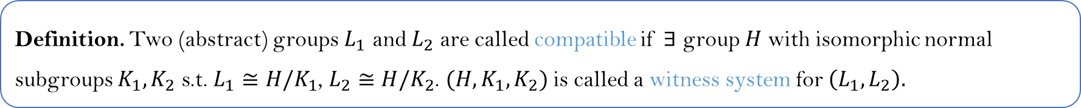
Compatibility (for abstract groups)
Definition. Two (abstract) groups $L_{1}$ and $L_{2}$ are called compatible if $∃$ group $H$ with isomorphic normal subgroups $K_{1},K_{2}$ s.t. $L_{1}≅H/K_{1}$, $L_{2}≅H/K_{2}$. $(H,K_{1},K_{2})$ is called a witness system for $\left(L_{1},L_{2}\right).$
Example. Let $L_{1}≔ℤ_{2}×ℤ_{2}$ and $L_{2}≔ℤ_{4}$. Let $H≔ℤ_{2}×ℤ_{4}, K_{1}≔1×ℤ_{2}$ and $K_{2}≔ℤ_{2}×1$. Then $H/K_{1}≅L_{1}$, $H/K_{2}≅L_{2}$ and $K_{1}≅K_{2}$. $(H,K_{1},K_{2})$ is a witness system for $(L_{1},L_{2})$. In par., $L_{1}$ and $L_{2}$ are compatible.

Slide 9
Compatibility
Determine compatible regular groups
Determine compatibility
Question 1. Sufficient conditions for compatibility?
Question 2. Necessary conditions for compatibility?

Slide 10
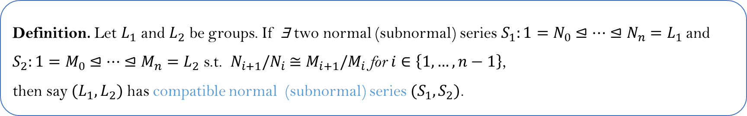

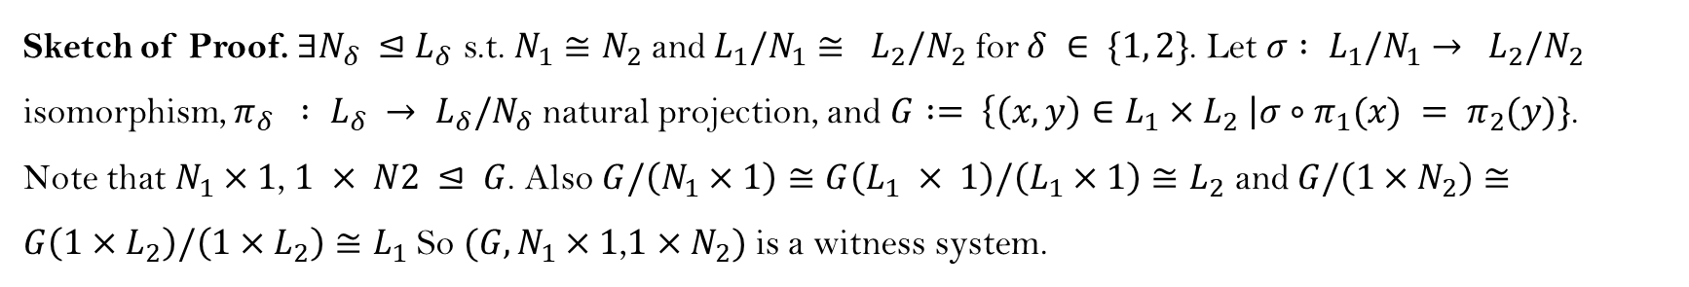
“X” $⟹$ Compatibility
Definition. Let $L_{1}$ and $L_{2}$ be groups. If ∃ two normal (subnormal) series$S_{1}:1=N_{0}⊴…⊴N_{n}=L_{1}$ and
$S_{2}:1=M_{0}⊴…⊴M_{n}=L_{2}$ s.t. $N_{i+1}/N_{i}$ $≅M_{i+1}/M_{i}$for $i∈\left\{1,…,n−1\right\}$,
then say ${(L}_{1},L_{2})$ has compatible normal (subnormal) series $(S_{1},S_{2})$.
Theorem. If $\left(L_{1},L_{2}\right)$ has a compatible normal series of length $2$, then $L_{1}$ and $L_{2}$ are compatible.
Sketch of Proof. $∃N_{δ} {⊴L}_{δ}$ s.t. $N_{1}≅N_{2}$ and $L_{1}/N_{1}≅ L_{2}/N_{2}$ for $δ ∈ \{1, 2\}$. Let $σ : L_{1}/N_{1}→ L_{2}/N_{2}$ isomorphism, $π_{δ} : L_{δ} → L_{δ}/N_{δ}$ natural projection, and $G := \left\{\left(x, y\right)∈L_{1}×L_{2} \right|σ∘π_{1}(x) = π_{2}(y)\}$.
Note that $N_{1}×1$, $1 × N2 ⊴ G$. Also $G/\left(N_{1}×1\right)≅G\left(L_{1} × 1\right)/\left(L_{1}×1\right)≅L_{2}$ and $G/\left(1×N_{2}\right)≅G\left(1×L_{2}\right)/\left(1×L_{2}\right)≅L_{1}$ So $(G,N_{1}×1\text{,}1×N_{2})$ is a witness system.

Slide 11

“X” $⟹$ Compatibility
Theorem (D, Verret). Compatible normal series + extra condition $⇒$ compatible.
Extra condition: Let $L_{δ}≔A_{1}._{δ}A_{2}._{δ}…._{δ}A_{ℓ}$ for $δ∈\left\{1,2\right\}.$ For $2≤i≤ℓ−1$ and $\left\{δ,ε\right\}=\{1,2\}$, we have
$$Inn{\left(A_{i}._{δ}…._{δ}A_{ℓ}\right)}^{A_{i}}≤{\left(Aut{\left(A_{i}._{ε}…._{ε}A_{ℓ}\right)}_{A_{i}}\right)}^{A_{i}}$$
Corollary. All nilpotent groups of the same order are compatible with each other. In par., all $p$-groups of the same order are compatible with each other.
Corollary. All groups of the same square-free order are compatible with each other.

Slide 12
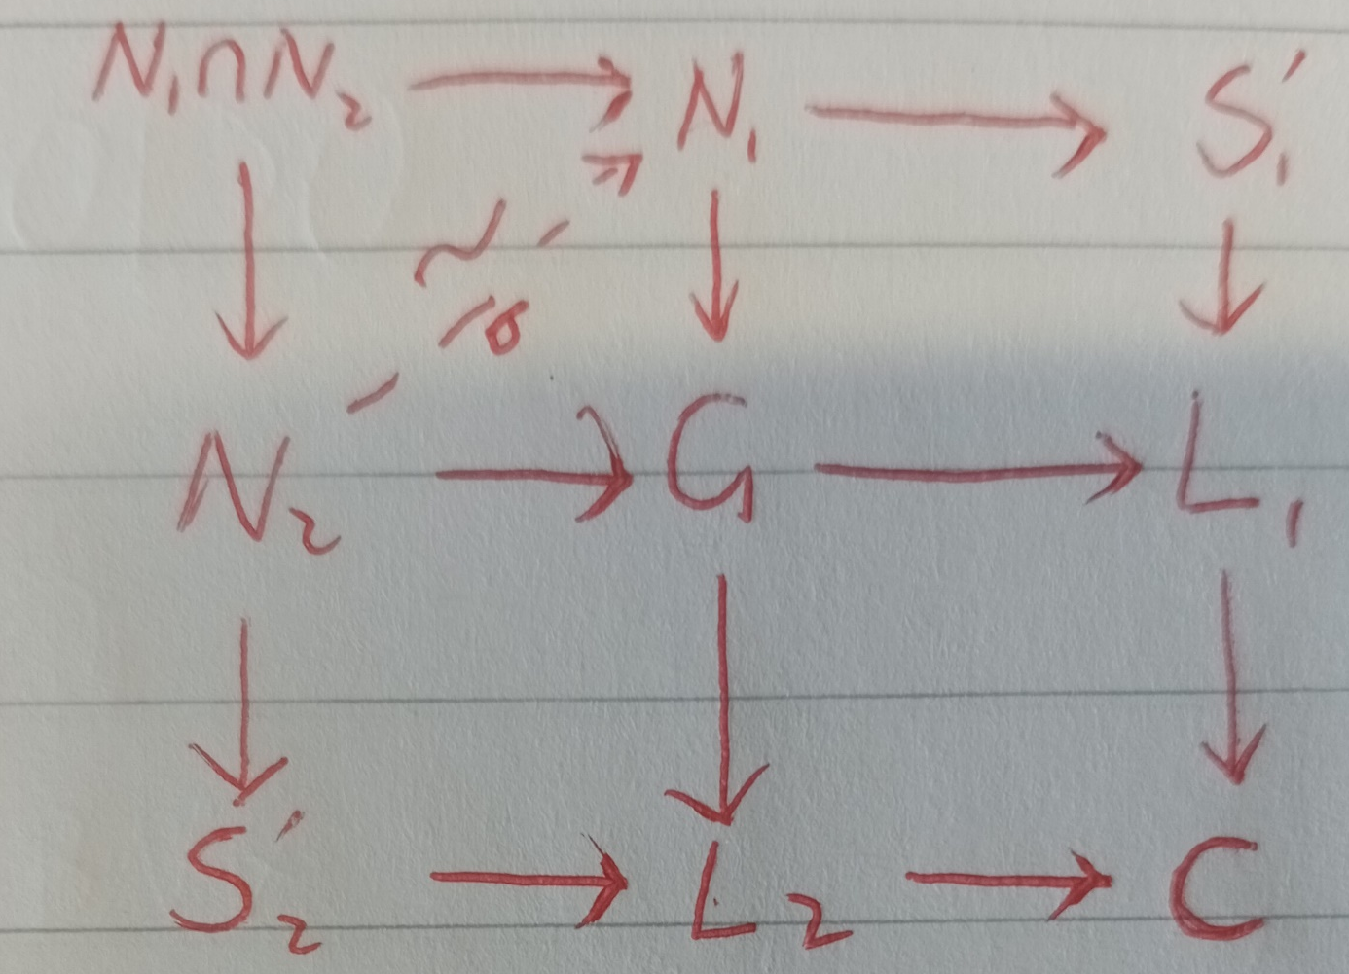

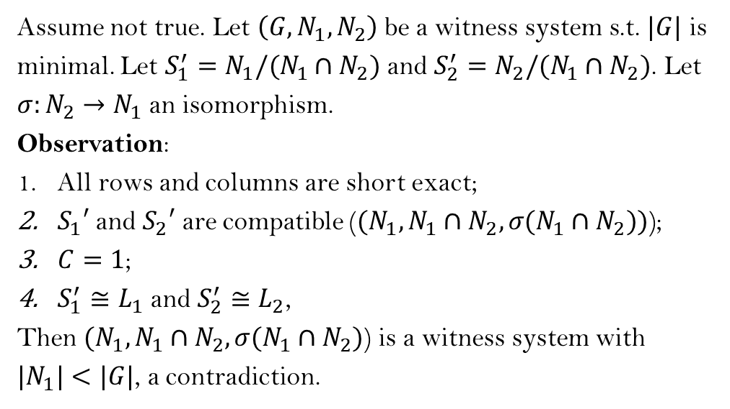
Compatibility $⇒$ “X”
Theorem (Sims’ Lemma). $L_{1}$ and $L_{2}$ are compatible $⇒$ $∃$ $S_{1}⊲L_{1}$ and $S_{2}⊲L_{2}$ s.t. $S_{1}$ and $S_{2}$ are compatible and $1≠L_{1}{/S}_{1}≅L_{2}/S_{2}$.
Assume not true. Let $\left(G,N_{1},N_{2}\right)$ be a witness system s.t. $|G|$ is minimal. Let $S_{1}^{′}=N_{1}/(N_{1}∩N_{2})$ and $S_{2}^{′}=N_{2}/(N_{1}∩N_{2})$. Let $σ:N_{2}→N_{1}$ an isomorphism.
Observation:
All rows and columns are short exact;
$S_{1}′$ and $S_{2}′$ are compatible (${(N}_{1},N_{1}∩N_{2},σ(N_{1}∩N_{2}))$);
$C=1$;
$S_{1}^{′}≅L_{1}$ and $S_{2}^{′}≅L_{2}$,
Then ${(N}_{1},N_{1}∩N_{2},σ(N_{1}∩N_{2})$) is a witness system with ${|N}_{1}|<|G|$, a contradiction.

Slide 13
Compatibility $⇒$ “X”
Theorem (Sims’ Lemma). $L_{1}$ and $L_{2}$ are compatible $⇒$ $∃$ $S_{1}⊲L_{1}$ and $S_{2}⊲L_{2}$ s.t. $S_{1}$ and $S_{2}$ are compatible and $1≠L_{1}{/S}_{1}≅L_{2}/S_{2}$.
Corollary. $L_{1}$ and $L_{2}$ are compatible $⇒$ $\left(L_{1},L_{2}\right)$ has compatible subnormal series.
Sketch of proof. Using induction on $|L_{1}|$.

Slide 14
Compatibility $⇒$ “X”
Theorem (D, Verret). Let $L_{1}$ and $L_{2}$ be compatible. If both $L_{1}$ and $L_{2}$ do not have cyclic composition factors, then $(L_{1},L_{2})$ has a compatible normal series.

Slide 15

Further comments
Conjecture. $L_{1}$ and $L_{2}$ are compatible $⇔$ $(L_{1},L_{2})$ has a compatible normal series.
Small exercise (?): Determine the compatibility of $A_{4}$ and $ℤ_{12}$.
Unsolved Problems in Group Theory. The Kourovka Notebook, 20th issue, 20.21
Proposition (D, Verret). If $(G,K_{1},K_{2})$ is a witness system of $(A_{4},ℤ_{12})$, then $\left|G\right|≥2^{10}⋅3$.

